Slide 1
“BIG IDEAS” OF THE CONSTITUTION
Limited Government
Republicanism
Checks & Balances
Federalism
Separation of Powers
Popular Sovereignty

Slide 2
“BIG IDEAS” OF THE CONSTITUTION
Limited Government
Government may only do things that the people have given it the power to do
Republicanism
A representative form of government organization
Checks & Balances
Each branch of government can check, or limit, the actions of the other branches

Slide 3
“BIG IDEAS” OF THE CONSTITUTION
Federalism
Political power should be divided between a central government and a number of regional governments
Separation of Powers
Power is divided into the executive, legislative, and judicial branches; these are equal and independent parts of government
Popular Sovereignty
The people are the source of all governmental power; government requires the consent of the governed

Slide 4
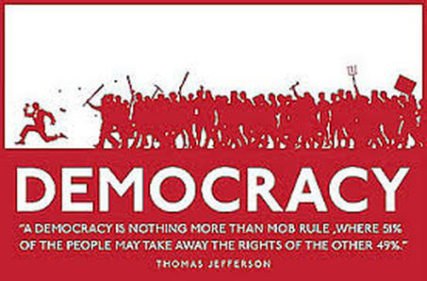
REPUBLICANISM

Slide 5
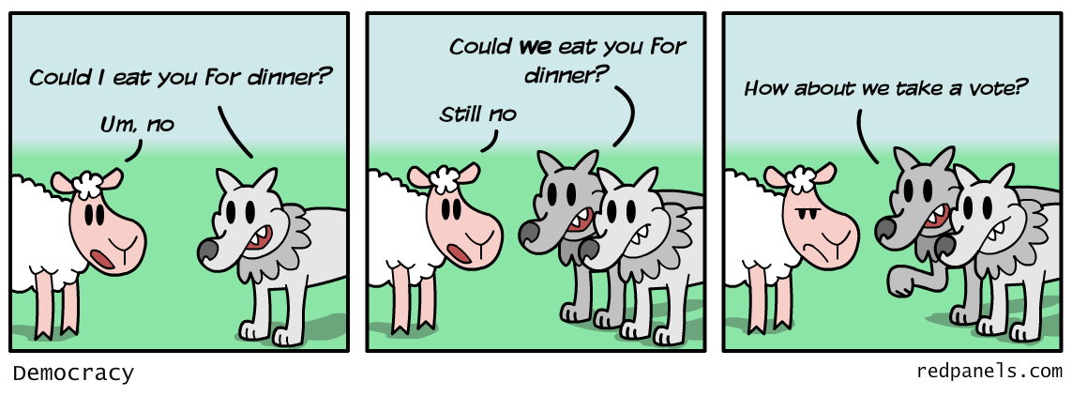
REPUBLICANISM

Slide 6
REPUBLICANISM THE FEDERALIST No. 10
“From this view of the subject it may be concluded that a pure democracy, by which I mean a society consisting of a small number of citizens, who assemble and administer the government in person, can admit of no cure for the mischiefs of faction. A common passion or interest will, in almost every case, be felt by a majority of the whole. ”

Slide 7
REPUBLICANISM THE FEDERALIST No. 10
“Hence it is that such democracies have ever been spectacles of turbulence and contention; have ever been found incompatible with personal security or the rights of property; and have in general been as short in their lives as they have been violent in their deaths.”

Slide 8
REPUBLICANISM
A) Public policy (i.e. laws and actions of the government) should reflect the opinion of voters.
B) Public policy should be created by officials who are most informed about the issues involved.
Do you believe that our country should more reflect the ideas of republicanism, or the ideas of democracy? Choose one of the two options on public policy and argue for it in a paragraph. Make sure to support your argument with evidence and reasoning.

